Slide 1
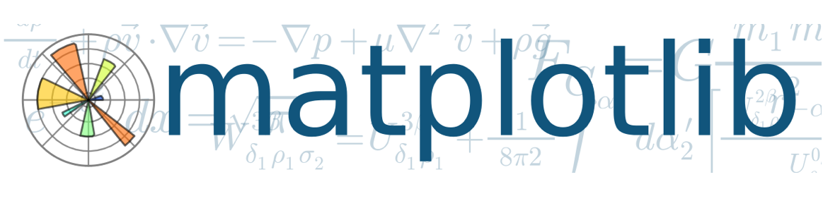
Sesion 8 – Matplotlib
Version 3.10
Msc Jorge Guerra Guerra
Data Science Instructor

Slide 2


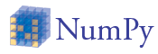

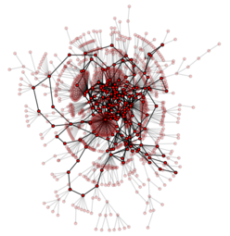

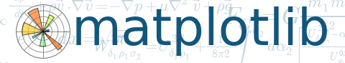



Slide 3
Introduccion
el trazado de los datos nos proporciona información visual
Flujo de trabajo típico:
escribir un programa en python para analizar los datos
pasar los datos a una herramienta de trazado para mostrar los resultados
con Matplotlib podemos conseguir el mismo resultado en un solo script y con más flexibilidad

Slide 4
interludio interactivo
el shell interactivo, estructuras de datos enriquecidas, matrices numpy, modo pylab
soporte de texto enriquecido, lo que ves es lo que obtienes, mathtext
manejo de eventos, incrustación de GUI
sitio web - sphinx

Slide 5
Matplotlib
hace uso de Numpy para proporcionar un buen rendimiento con grandes matrices de datos
permite la publicación de gráficos de calidad
al ser un módulo de Python puede integrarse fácilmente en un programa de Python

Slide 6
importar modulo
Seamos coherentes con la documentación oficial
$ (i)python
>>> import matplotlib.pyplot as plt

Slide 7
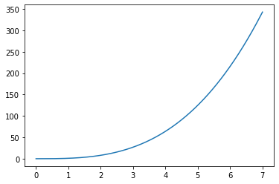
Matplotlib 1er ejemplo
>>> # following imports are not necessary if --pylab
>>> import matplotlib.pyplot as plt
>>> import numpy as np
>>> plt.interactive('on') # set interactive
# no need with --pylab
>>> x = np.arange(0,7,0.00001)
>>> plt.plot(x,x**3) # x,y values of the plot
[<matplotlib.lines.Line2D object at 0xa1750cc>]
>>> plt.show()

Slide 8
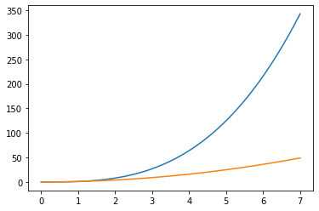
Matplotlib: gráfico de líneas múltiples
>>> x = np.arange(0,7,0.00001)
>>> plt.plot(x,x**3)
>>> plt.plot(x,x**2)
>>> plt.show()
O pasando múltiples argumentos (x,y) a la función de trazado
>>> x = np.arange(0,7,0.00001)
>>> plt.plot(x,x**3, x,x**2)
>>> plt.show()

Slide 9
Comandos de control de trama (plot)
Classic plot interaction is available
>>> plt.grid()
>>> plt.axis() # shows the current axis limits values
>>> plt.axis([0,5,0,10]) #[xmin,xmax,ymin,ymax]
>>> plt.xlabel('This is the X axis')
>>> plt.title('Outstanding title here')
>>> plt.legend(['Fast', 'SuperFast'],loc=2)
>>> plt.savefig('plot123.png', dpi=250)
extension determines the file format

Slide 10
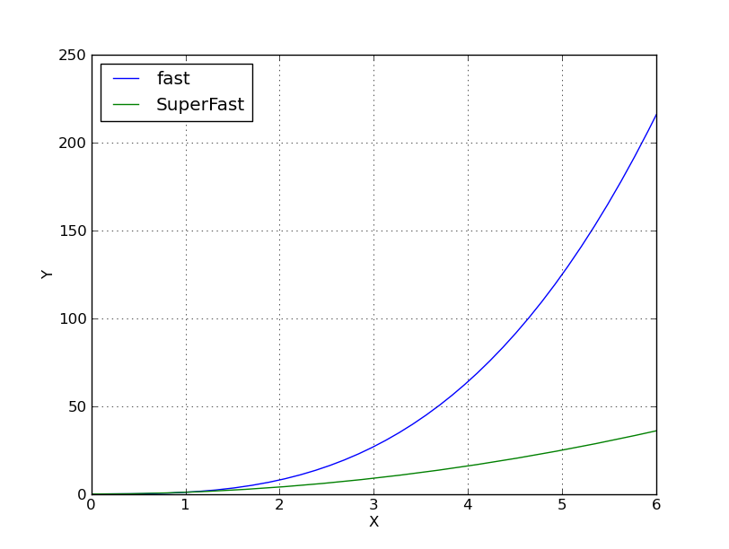
Plot example

Slide 11
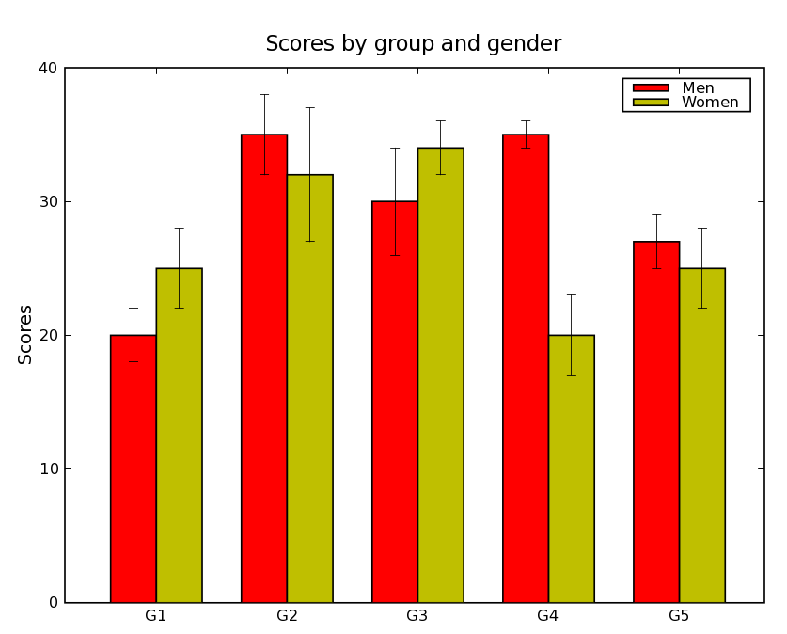
bar graphics

Slide 12
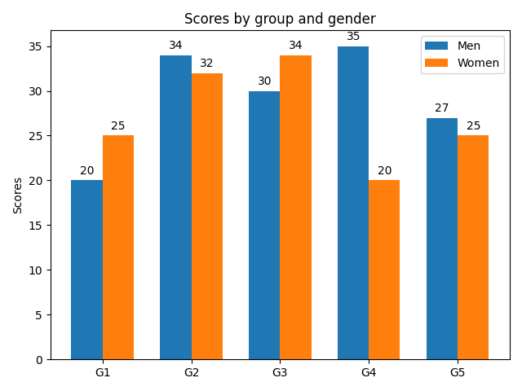
import matplotlib.pyplot as plt
import numpy as np
labels = ['G1', 'G2', 'G3', 'G4', 'G5']
men_means = [20, 34, 30, 35, 27]
women_means = [25, 32, 34, 20, 25]
x = np.arange(len(labels)) # the label locations
width = 0.35 # the width of the bars
fig, ax = plt.subplots()
rects1 = ax.bar(x - width/2, men_means, width, label='Men')
rects2 = ax.bar(x + width/2, women_means, width, label='Women')
# Add some text for labels, title and custom x-axis tick labels, etc.
ax.set_ylabel('Scores')
ax.set_title('Scores by group and gender')
ax.set_xticks(x, labels)
ax.legend()
ax.bar_label(rects1, padding=3)
ax.bar_label(rects2, padding=3)
fig.tight_layout()
plt.show()

Slide 13
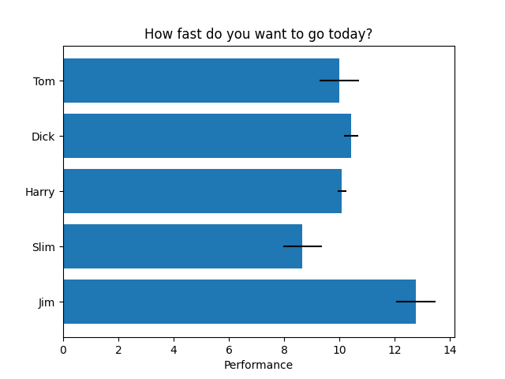
import matplotlib.pyplot as plt
import numpy as np
# Fixing random state for reproducibility
np.random.seed(19680801)
plt.rcdefaults()
fig, ax = plt.subplots()
# Example data
people = ('Tom', 'Dick', 'Harry', 'Slim', 'Jim')
y_pos = np.arange(len(people))
performance = 3 + 10 * np.random.rand(len(people))
error = np.random.rand(len(people))
ax.barh(y_pos, performance, xerr=error, align='center')
ax.set_yticks(y_pos, labels=people)
ax.invert_yaxis() # labels read top-to-bottom
ax.set_xlabel('Performance')
ax.set_title('How fast do you want to go today?')
plt.show()

Slide 14
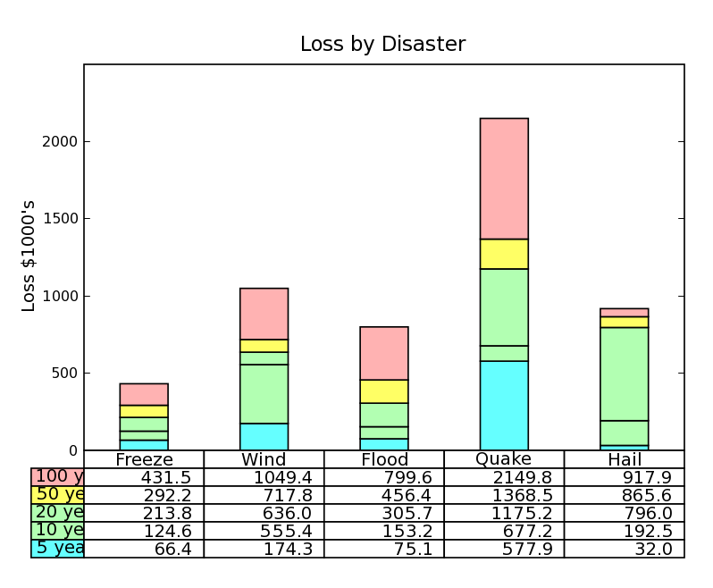
stacked bar
Notes:
Table demo

Slide 15
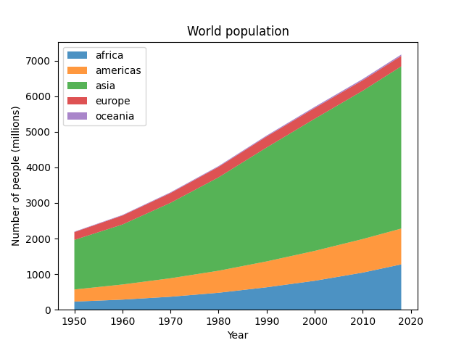
# Fixing random state for reproducibility
np.random.seed(19680801)
def gaussian_mixture(x, n=5):
"""Return a random mixture of *n* Gaussians, evaluated at positions *x*."""
def add_random_gaussian(a):
amplitude = 1 / (.1 + np.random.random())
dx = x[-1] - x[0]
x0 = (2 * np.random.random() - .5) * dx
z = 10 / (.1 + np.random.random()) / dx
a += amplitude * np.exp(-(z * (x - x0))**2)
a = np.zeros_like(x)
for j in range(n):
add_random_gaussian(a)
return a
x = np.linspace(0, 100, 101)
ys = [gaussian_mixture(x) for _ in range(3)]
fig, ax = plt.subplots()
ax.stackplot(x, ys, baseline='wiggle')
plt.show()

Slide 16
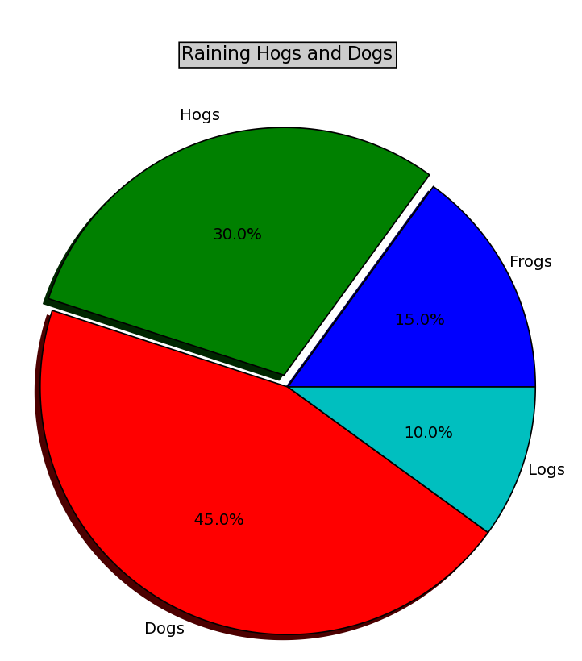
pie graphic

Slide 17
import numpy as np
import matplotlib.pyplot as plt
fig, ax = plt.subplots(figsize=(6, 3), subplot_kw=dict(aspect="equal"))
recipe = ["375 g flour",
"75 g sugar",
"250 g butter",
"300 g berries"]
data = [float(x.split()[0]) for x in recipe]
ingredients = [x.split()[-1] for x in recipe]
def func(pct, allvals):
absolute = int(np.round(pct/100.*np.sum(allvals)))
return "{:.1f}%\n({:d} g)".format(pct, absolute)
wedges, texts, autotexts = ax.pie(data, autopct=lambda pct: func(pct, data),
textprops=dict(color="w"))
ax.legend(wedges, ingredients,
title="Ingredients",
loc="center left",
bbox_to_anchor=(1, 0, 0.5, 1))
plt.setp(autotexts, size=8, weight="bold")
ax.set_title("Matplotlib bakery: A pie")
plt.show()

Slide 18
import numpy as np
import matplotlib.pyplot as plt
# Fixing random state for reproducibility
np.random.seed(19680801)
# fake up some data
spread = np.random.rand(50) * 100
center = np.ones(25) * 50
flier_high = np.random.rand(10) * 100 + 100
flier_low = np.random.rand(10) * -100
data = np.concatenate((spread, center, flier_high, flier_low)
fig4, ax4 = plt.subplots()
ax4.set_title('Hide Outlier Points')
ax4.boxplot(data, showfliers=False)

Slide 19
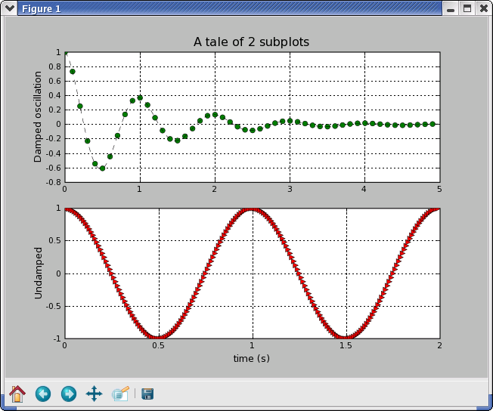
subplot graphic
Notes:
Subplot demo - interaction toolbar

Slide 20
import numpy as np
import matplotlib.pyplot as plt
def f(t):
return np.exp(-t) * np.cos(2*np.pi*t)
t1 = np.arange(0.0, 5.0, 0.1)
t2 = np.arange(0.0, 5.0, 0.02)
plt.figure()
plt.subplot(211)
plt.plot(t1, f(t1), color='tab:blue', marker='o')
plt.plot(t2, f(t2), color='black')
plt.subplot(212)
plt.plot(t2, np.cos(2*np.pi*t2), color='tab:orange', linestyle='--')
plt.show()

Slide 21
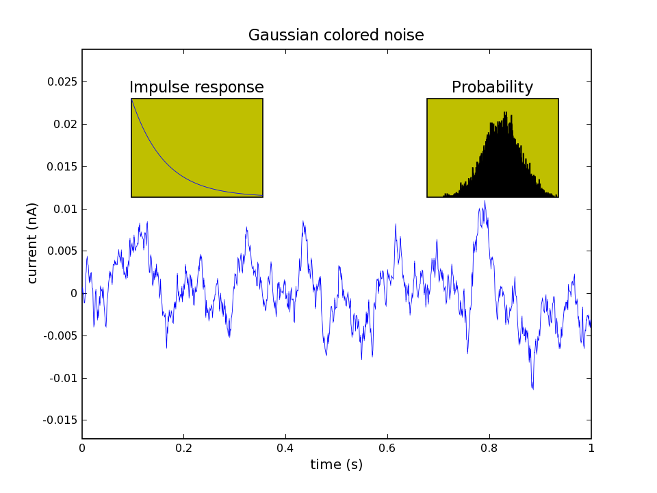
axes graphic

Slide 22
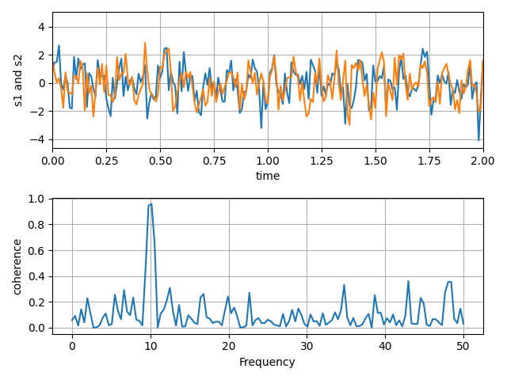
import numpy as np
import matplotlib.pyplot as plt
# Fixing random state for reproducibility
np.random.seed(19680801)
dt = 0.01
t = np.arange(0, 30, dt)
nse1 = np.random.randn(len(t)) # white noise 1
nse2 = np.random.randn(len(t)) # white noise 2
# Two signals with a coherent part at 10Hz and a random part
s1 = np.sin(2 * np.pi * 10 * t) + nse1
s2 = np.sin(2 * np.pi * 10 * t) + nse2
fig, axs = plt.subplots(2, 1)
axs[0].plot(t, s1, t, s2)
axs[0].set_xlim(0, 2)
axs[0].set_xlabel('time')
axs[0].set_ylabel('s1 and s2')
axs[0].grid(True)
cxy, f = axs[1].cohere(s1, s2, 256, 1. / dt)
axs[1].set_ylabel('coherence')
fig.tight_layout()
plt.show()

Slide 23
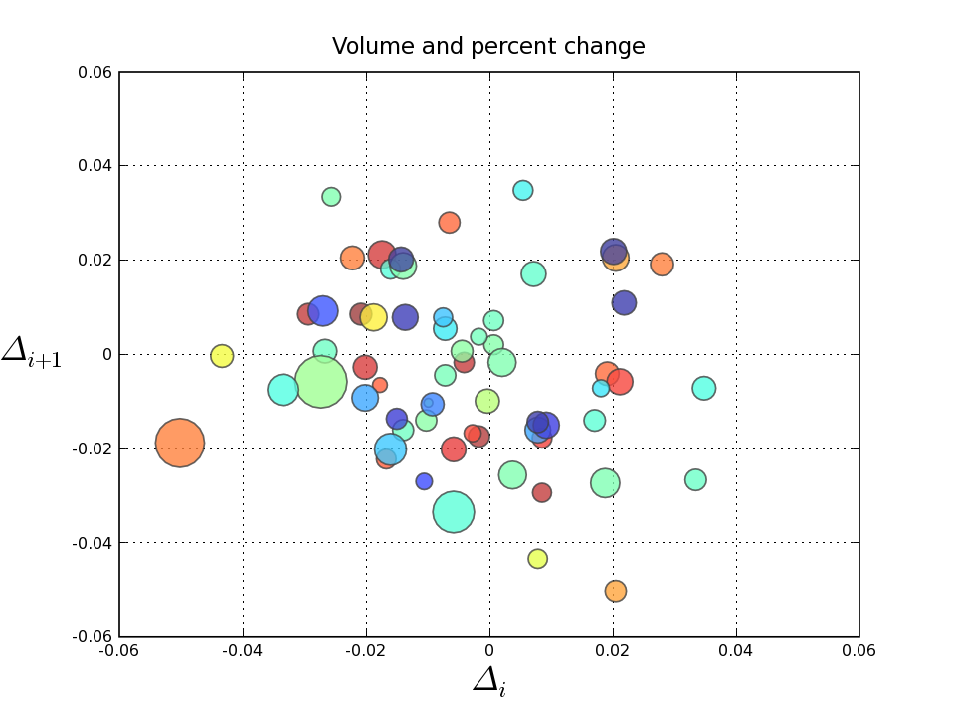
scatter graphic
Notes:
Scatter demo

Slide 24
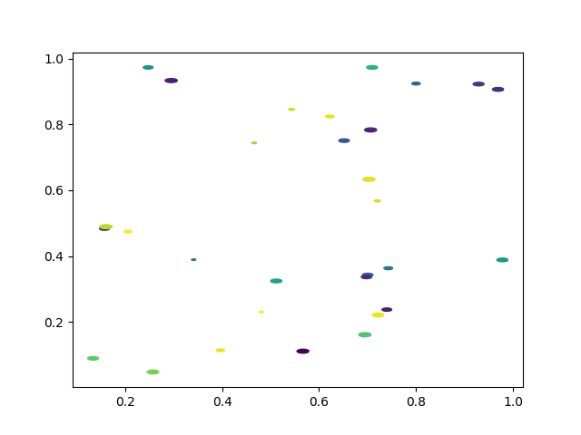
import matplotlib.pyplot as plt
import numpy as np
# Fixing random state for reproducibility
np.random.seed(19680801)
# unit area ellipse
rx, ry = 3., 1.
area = rx * ry * np.pi
theta = np.arange(0, 2 * np.pi + 0.01, 0.1)
verts = np.column_stack([rx / area * np.cos(theta), ry / area * np.sin(theta)])
x, y, s, c = np.random.rand(4, 30)
s *= 10**2.
fig, ax = plt.subplots()
ax.scatter(x, y, s, c, marker=verts)
plt.show()

Slide 25
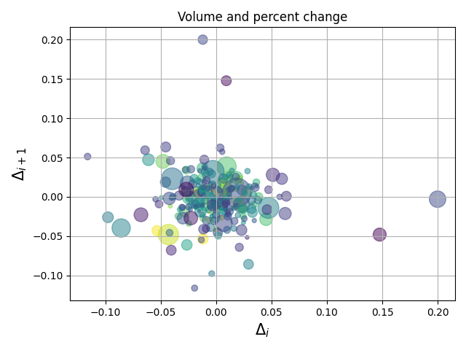
import numpy as np
import matplotlib.pyplot as plt
import matplotlib.cbook as cbook
# Load a numpy record array from yahoo csv data with fields date, open, close,
# volume, adj_close from the mpl-data/example directory. The record array
# stores the date as an np.datetime64 with a day unit ('D') in the date column.
price_data = (cbook.get_sample_data('goog.npz', np_load=True)['price_data']
.view(np.recarray))
price_data = price_data[-250:] # get the most recent 250 trading days
delta1 = np.diff(price_data.adj_close) / price_data.adj_close[:-1]
# Marker size in units of points^2
volume = (15 * price_data.volume[:-2] / price_data.volume[0])**2
close = 0.003 * price_data.close[:-2] / 0.003 * price_data.open[:-2]
fig, ax = plt.subplots()
ax.scatter(delta1[:-1], delta1[1:], c=close, s=volume, alpha=0.5)
ax.set_xlabel(r'$\Delta_i$', fontsize=15)
ax.set_ylabel(r'$\Delta_{i+1}$', fontsize=15)
ax.set_title('Volume and percent change')
ax.grid(True)
fig.tight_layout()
plt.show()

Slide 26
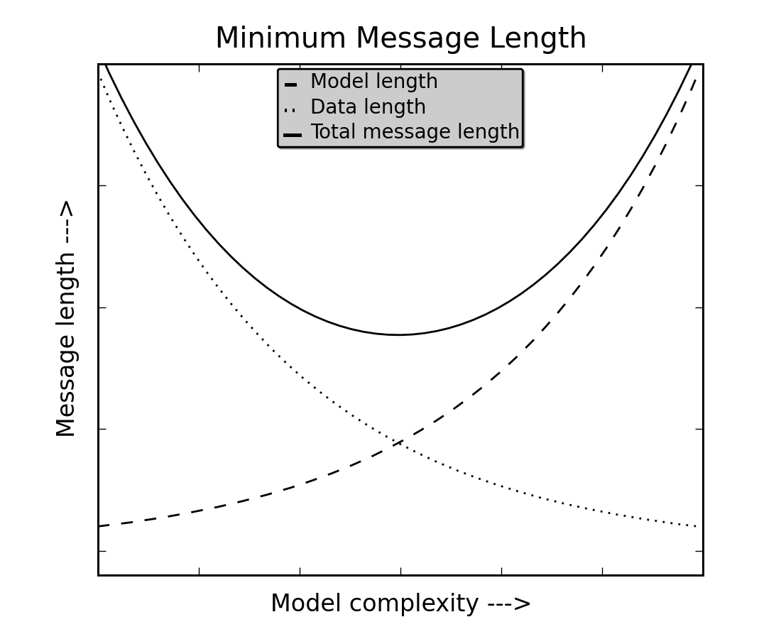
Ejemplo leyenda

Slide 27
import numpy as np
import matplotlib.pyplot as plt
# Make some fake data.
a = b = np.arange(0, 3, .02)
c = np.exp(a)
d = c[::-1]
# Create plots with pre-defined labels.
fig, ax = plt.subplots()
ax.plot(a, c, 'k--', label='Model length')
ax.plot(a, d, 'k:', label='Data length')
ax.plot(a, c + d, 'k', label='Total message length')
legend = ax.legend(loc='upper center', shadow=True, fontsize='x-large')
# Put a nicer background color on the legend.
legend.get_frame().set_facecolor('C0')
plt.show()

Slide 28
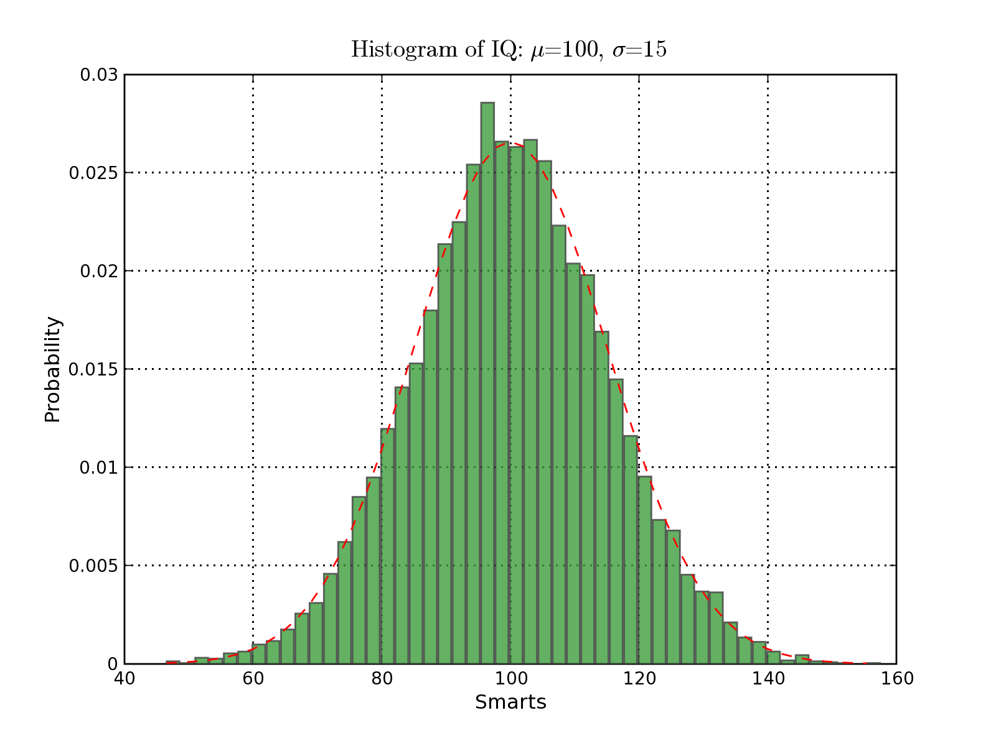
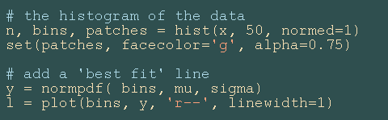
histogram graphics
Notes:
Histogram demo

Slide 29
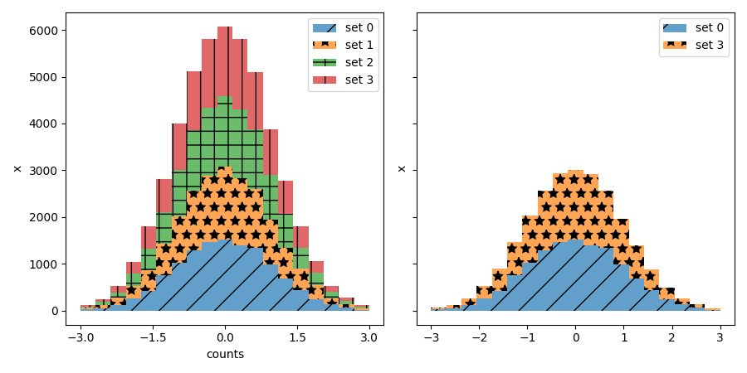
Hatch-filled histograms
def stack_hist(ax, stacked_data, sty_cycle, bottoms=None,
hist_func=None, labels=None,
plot_func=None, plot_kwargs=None):
"""
Parameters
----------
ax : axes.Axes
The axes to add artists too
stacked_data : array or Mapping
A (M, N) shaped array. The first dimension will be iterated over to
compute histograms row-wise
sty_cycle : Cycler or operable of dict
Style to apply to each set
bottoms : array, default: 0
The initial positions of the bottoms.
hist_func : callable, optional
Must have signature `bin_vals, bin_edges = f(data)`.
`bin_edges` expected to be one longer than `bin_vals`
fig, (ax1, ax2) = plt.subplots(1, 2, figsize=(9, 4.5),
tight_layout=True, sharey=True)
arts = stack_hist(ax1, dict_data, color_cycle + hatch_cycle,
hist_func=hist_func)
arts = stack_hist(ax2, dict_data, color_cycle + hatch_cycle,
hist_func=hist_func, labels=['set 0', 'set 3'])
ax1.xaxis.set_major_locator(mticker.MaxNLocator(5))
ax1.set_xlabel('counts')
ax1.set_ylabel('x')
ax2.set_ylabel('x')
plt.show()

Slide 30
import numpy as np
import matplotlib.pyplot as plt
np.random.seed(19680801)
mu_x = 200
sigma_x = 25
x = np.random.normal(mu_x, sigma_x, size=100)
mu_w = 200
sigma_w = 10
w = np.random.normal(mu_w, sigma_w, size=100)
fig, axs = plt.subplots(nrows=2, ncols=2)
axs[0, 0].hist(x, 20, density=True, histtype='stepfilled', facecolor='g',
alpha=0.75)
axs[0, 0].set_title('stepfilled')
axs[0, 1].hist(x, 20, density=True, histtype='step', facecolor='g',
alpha=0.75)
axs[0, 1].set_title('step')
axs[1, 0].hist(x, density=True, histtype='barstacked', rwidth=0.8)
axs[1, 0].hist(w, density=True, histtype='barstacked', rwidth=0.8)
axs[1, 0].set_title('barstacked')
# Create a histogram by providing the bin edges (unequally spaced).
bins = [100, 150, 180, 195, 205, 220, 250, 300]
axs[1, 1].hist(x, bins, density=True, histtype='bar', rwidth=0.8)
axs[1, 1].set_title('bar, unequal bins')
fig.tight_layout()
plt.show()

Slide 31
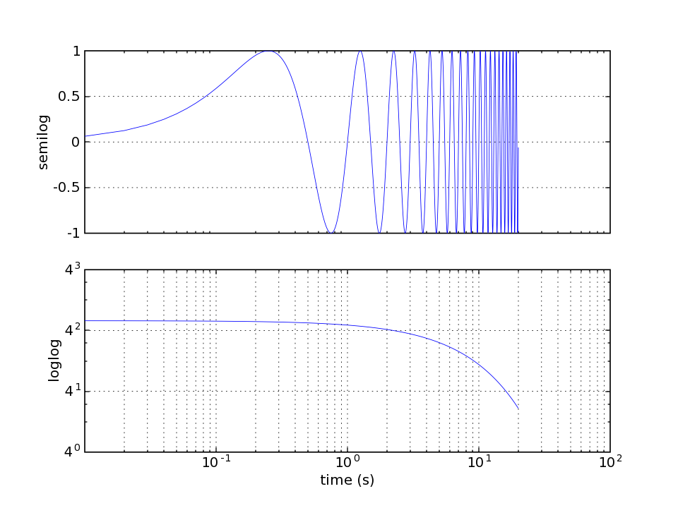
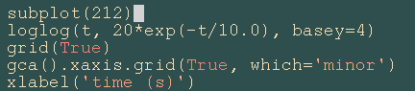
log demo
Notes:
Log demo

Slide 32
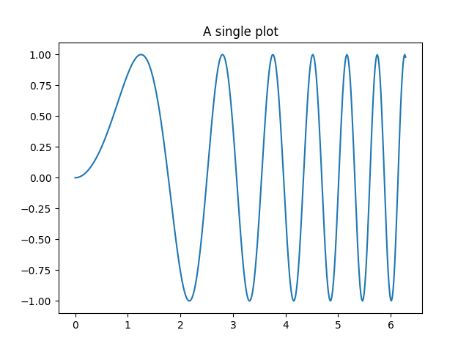
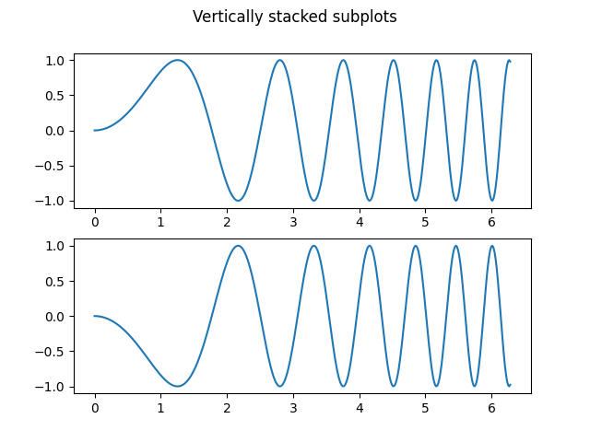
fig, ax = plt.subplots()
ax.plot(x, y)
ax.set_title('A single plot')
fig, (ax1, ax2) = plt.subplots(2)
fig.suptitle('Vertically stacked subplots')
ax1.plot(x, y)
ax2.plot(x, -y)

Slide 33
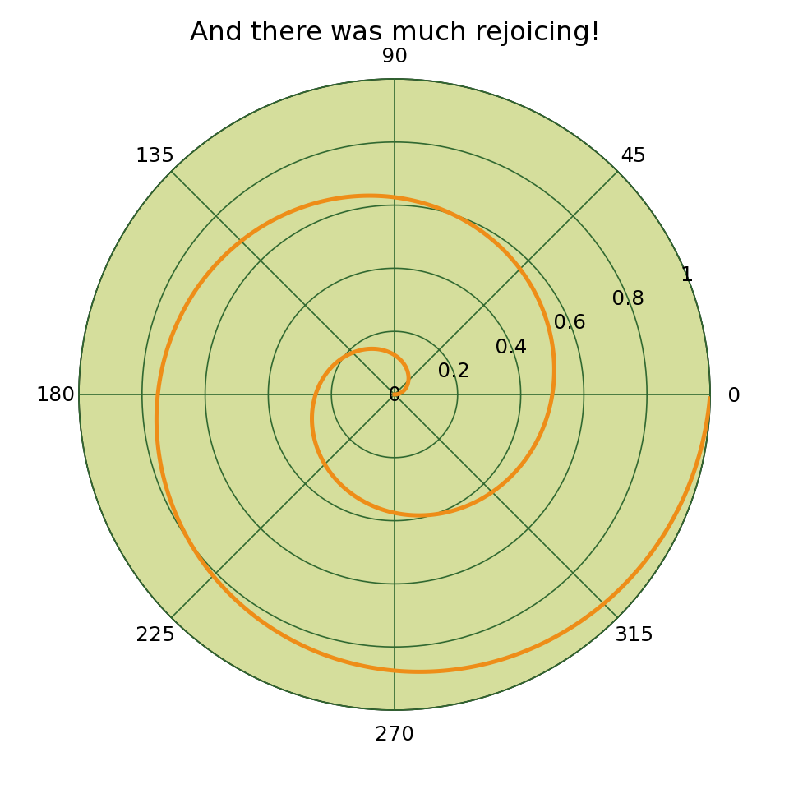
polar demo

Slide 34
import matplotlib.pyplot as plt
import numpy as np
fig = plt.figure()
ax = fig.add_subplot(projection="polar", facecolor="lightgoldenrodyellow")
r = np.linspace(0, 3, 301)
theta = 2 * np.pi * r
ax.plot(theta, r, color="tab:orange", lw=3, label="a line")
ax.plot(0.5 * theta, r, color="tab:blue", ls="--", lw=3, label="another line")
ax.tick_params(grid_color="palegoldenrod")
# For polar axes, it may be useful to move the legend slightly away from the
# axes center, to avoid overlap between the legend and the axes. The following
# snippet places the legend's lower left corner just outside of the polar axes
# at an angle of 67.5 degrees in polar coordinates.
angle = np.deg2rad(67.5)
ax.legend(loc="lower left",
bbox_to_anchor=(.5 + np.cos(angle)/2, .5 + np.sin(angle)/2))
plt.show()
Polar Legend

Slide 35
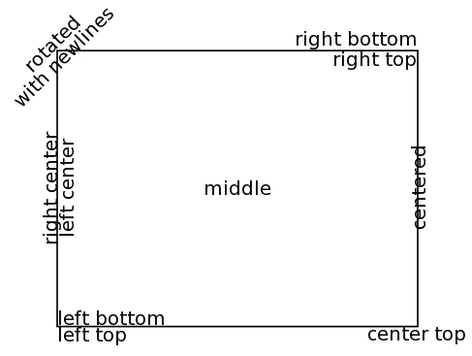
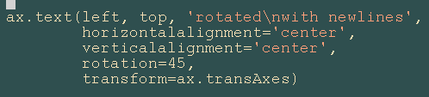
text alignment

Slide 36
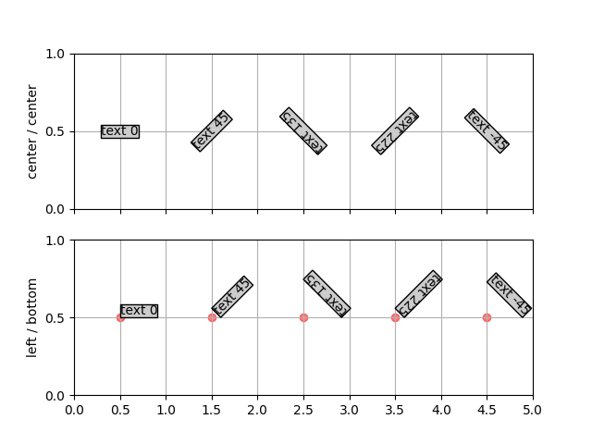
import matplotlib.pyplot as plt
import numpy as np
def addtext(ax, props):
ax.text(0.5, 0.5, 'text 0', props, rotation=0)
ax.text(1.5, 0.5, 'text 45', props, rotation=45)
ax.text(2.5, 0.5, 'text 135', props, rotation=135)
ax.text(3.5, 0.5, 'text 225', props, rotation=225)
ax.text(4.5, 0.5, 'text -45', props, rotation=-45)
for x in range(0, 5):
ax.scatter(x + 0.5, 0.5, color='r', alpha=0.5)
ax.set_yticks([0, .5, 1])
ax.set_xticks(np.arange(0, 5.1, 0.5))
ax.set_xlim(0, 5)
ax.grid(True)
# the text bounding box
bbox = {'fc': '0.8', 'pad': 0}
fig, axs = plt.subplots(2, 1, sharex=True)
addtext(axs[0], {'ha': 'center', 'va': 'center', 'bbox': bbox})
axs[0].set_ylabel('center / center')
addtext(axs[1], {'ha': 'left', 'va': 'bottom', 'bbox': bbox})
axs[1].set_ylabel('left / bottom')
plt.show()

Slide 37
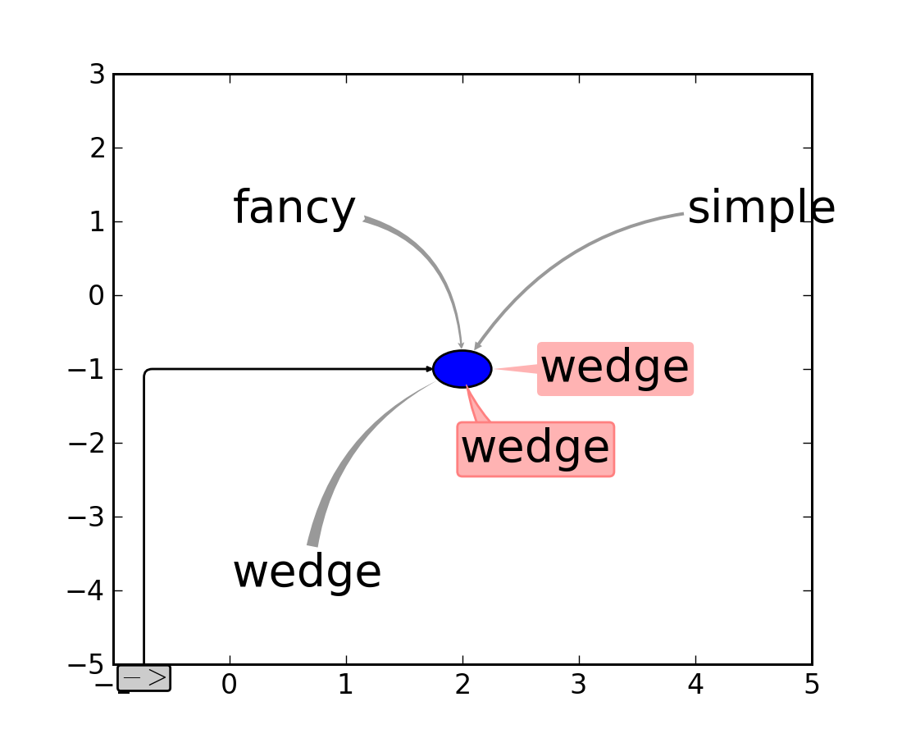

Slide 38
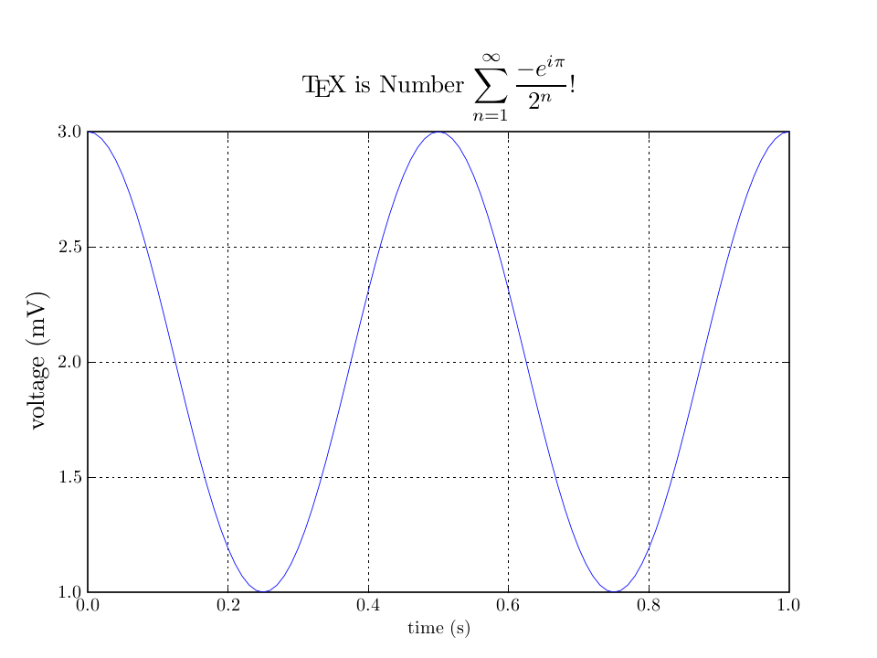
matplotlib screenshot
TeX support

Slide 39
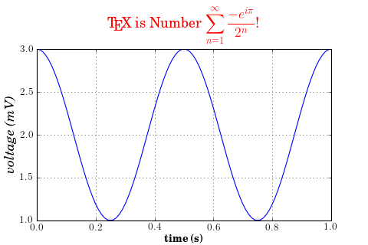
from matplotlib import rc
from numpy import arange, cos, pi
from matplotlib.pyplot import figure, axes, plot, xlabel, ylabel, title, \
grid, savefig, show
rc('text', usetex=True)
rc('font', family='serif')
figure(1, figsize=(6,4))
ax = axes([0.1, 0.1, 0.8, 0.7])
t = arange(0.0, 1.0+0.01, 0.01)
s = cos(2*2*pi*t)+2
plot(t, s)
xlabel(r'\textbf{time (s)}')
ylabel(r'\textit{voltage (mV)}',fontsize=16)
title(r"\TeX\ is Number $\displaystyle\sum_{n=1}^\infty\frac{-e^{i\pi}}{2^n}$!",
fontsize=16, color='r')
grid(True)
savefig('tex_demo')
show()

Slide 40
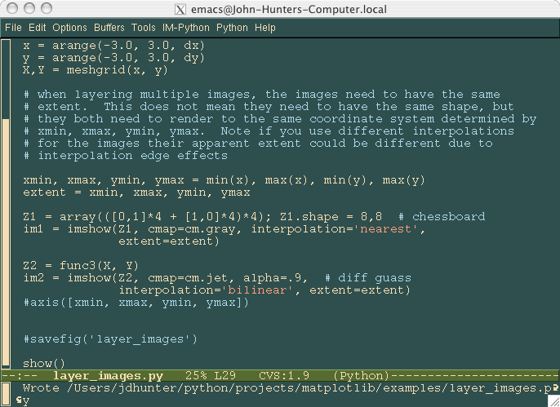
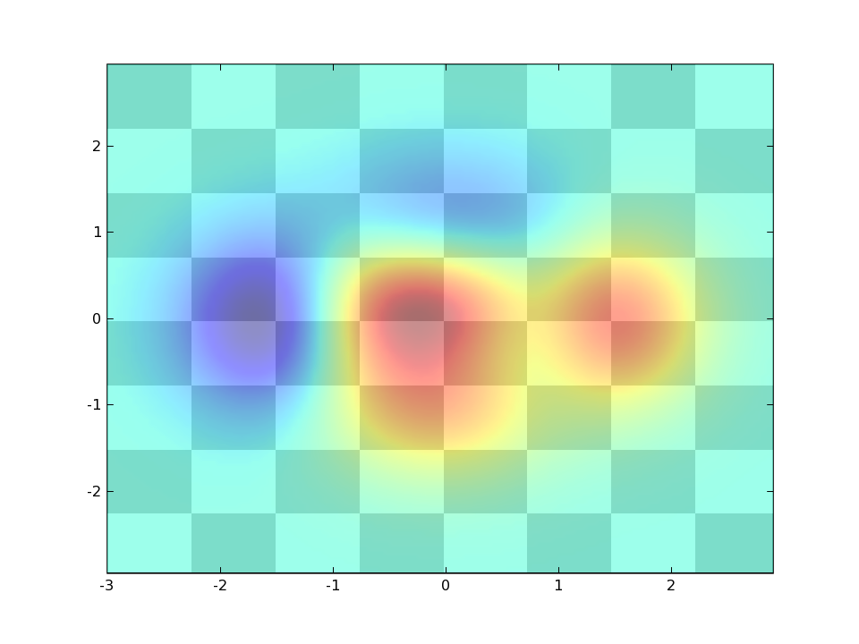
layer image
Notes:
Layer images

Slide 41
import numpy as np
import matplotlib.cm as cm
import matplotlib.pyplot as plt
import matplotlib.cbook as cbook
from matplotlib.path import Path
from matplotlib.patches import PathPatch
# Fixing random state for reproducibility
np.random.seed(19680801)
delta = 0.025
x = y = np.arange(-3.0, 3.0, delta)
X, Y = np.meshgrid(x, y)
Z1 = np.exp(-X**2 - Y**2)
Z2 = np.exp(-(X - 1)**2 - (Y - 1)**2)
Z = (Z1 - Z2) * 2
fig, ax = plt.subplots()
im = ax.imshow(Z, interpolation='bilinear', cmap=cm.RdYlGn,
origin='lower', extent=[-3, 3, -3, 3],
vmax=abs(Z).max(), vmin=-abs(Z).max())
plt.show()

Slide 42
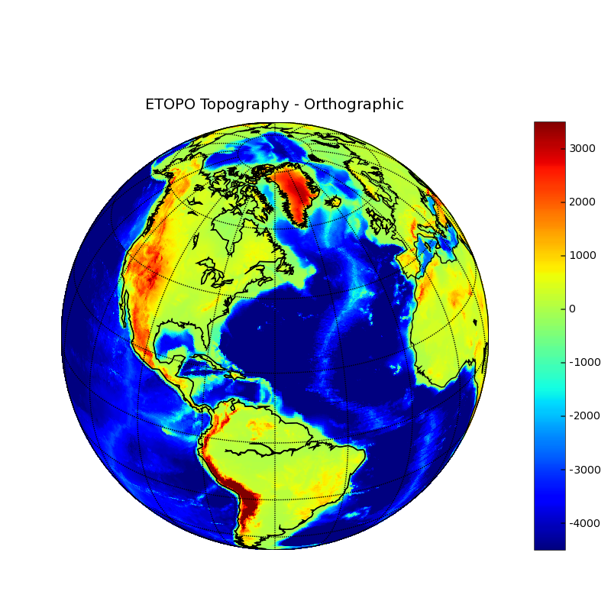
basemap toolkit
(courtesy of NOAA)‏

Slide 43
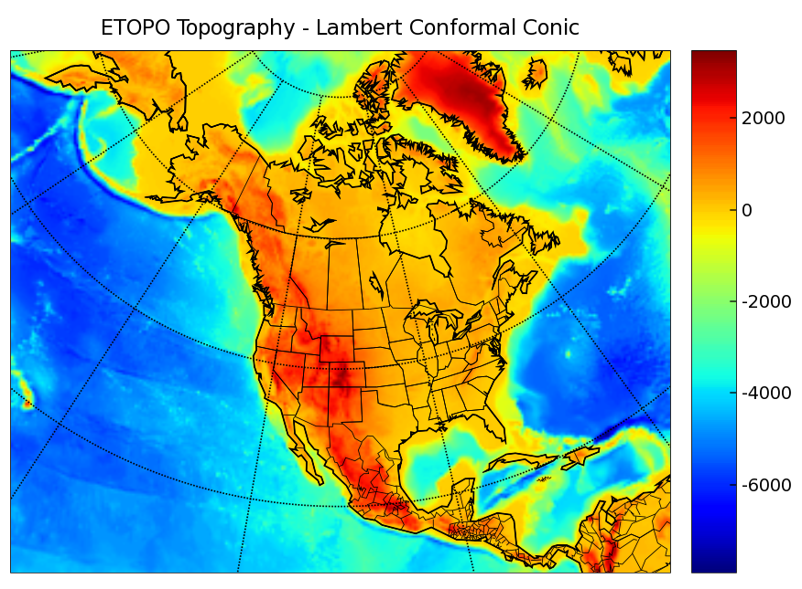
basemap toolkit
cylindrical equidistant, mercator, lambert conformal conic, lambert azimuthal equal area, albers equal area conic and stereographic.

Slide 44
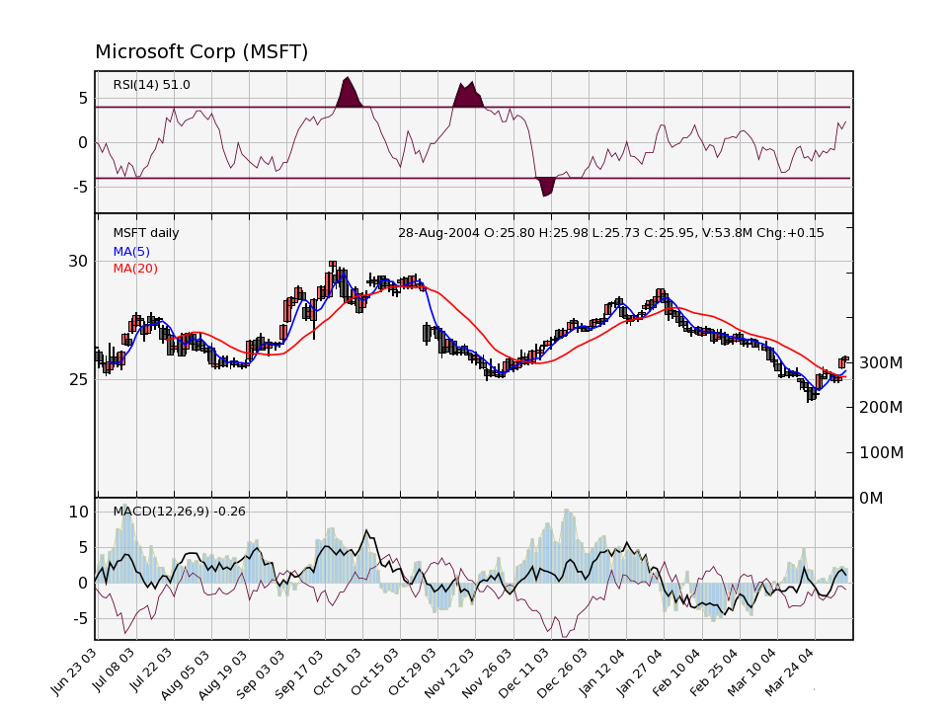
finance demo

